Slide 1
Final Project Presentation:
Mano CPU Architecture With Customable Instruction Set
Yuval Tzur

Slide 2
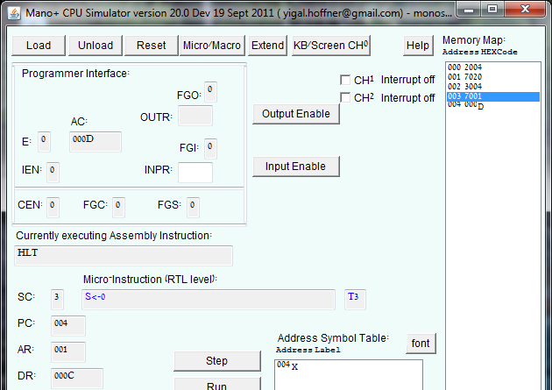
All of you know this:

Slide 3
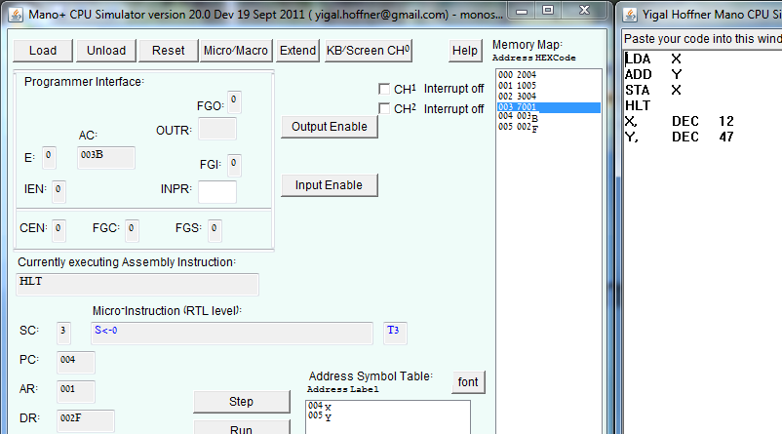
Task:
Create a program that calculates x+y.
Answer:

Slide 4
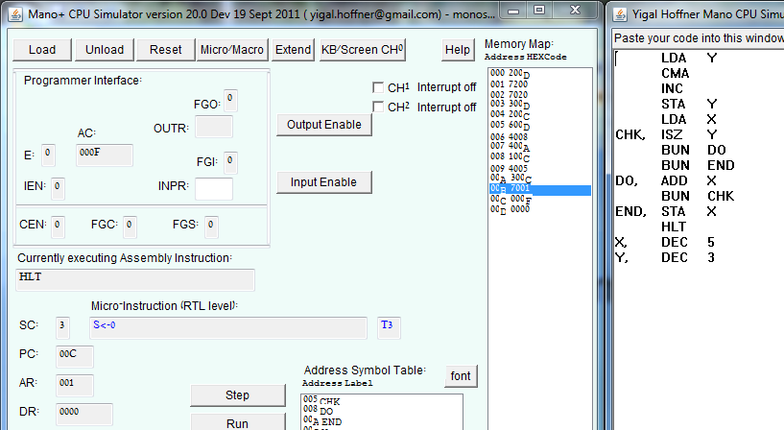
A harder task:
Create a program that calculates x*y.
Answer:

Slide 5
So far, so good!
Now we’ll try something different…

Slide 6
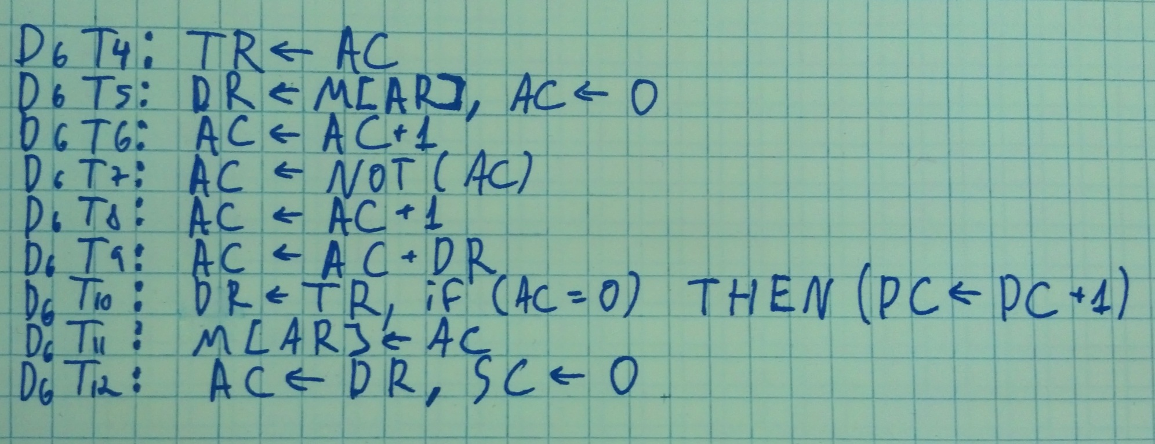
Task:
Using the Mano CPU architecture, create the following instruction instead of ISZ:
DSZ M // [M] = [M] - 1; Skip if [M] = 0;
// Decrement and skip if zero.
// Keep the value of the AC as is.
Answer:

Slide 7
Problems:
Students can’t experiment with instruction editing.
Students can’t experiment with instruction creation.
The emulator is bound by the Mano CPU instruction set.
The emulator is bound by the Mano CPU instruction format.

Slide 8
Is there a solution?
The emulator is purely software – No hardware limitations.
The micro operations are very similar to one another.
The hardware is composed of separate entities with definitive functionality.
Each hardware component is easily emulated with software.

Slide 9
Solution Implementation:
Using OOP, we can create different software entities that mimic components’ functionality.
All the components will be assembled into a CPU with an API we can interact with.
Using a specially built compiler, a simple to use set of micro-operations can be converted into code that activates the CPU API.
Once compiled, the emulator will be used the same way it works now, but with a new set of instructions.

Slide 10
Questions?

